Slide 1
Flash Loan Decentralized Exchanges
24/08/2021

Slide 2
Introduction – Flash Loan
FL is a feature that allows you to borrow any available amount of assets
From a designated smart contract pool with no collateral.
FL are useful building blocks in DeFi
They can be used for things like arbitrage, swapping collateral and self-liquidation

Slide 3
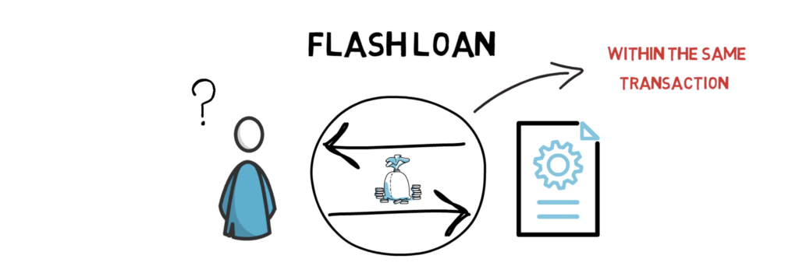
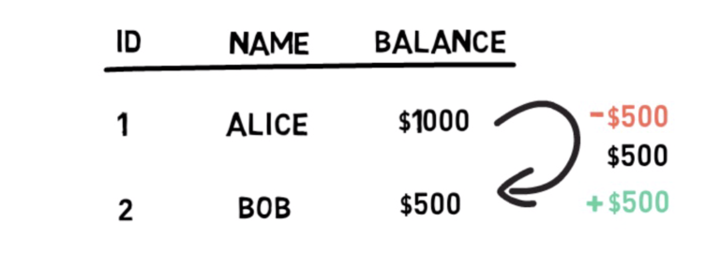
Introduction - FL
A flash loan has to be borrowed and repaid within the same blockchain transaction
The concept of a transaction on a BC is no different to the traditional definition of a transaction in computer science
A transaction represents a set of operations that must be executed in an atomic way

Slide 4
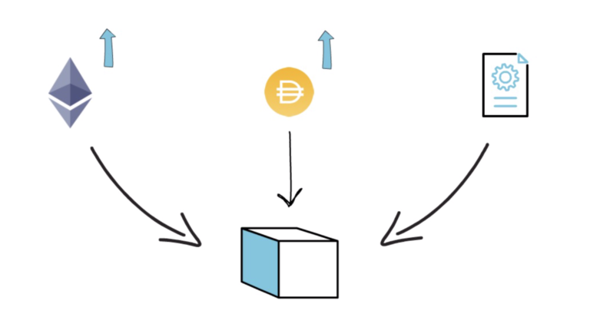
Ethereum Transactions
Every common operation, such as sending ETH, ERC20 tokens and interacting with smart contracts are executed within a transaction scope
Transactions are grouped together and included in blocks
On Etherscan we can monitor transactions

Slide 5
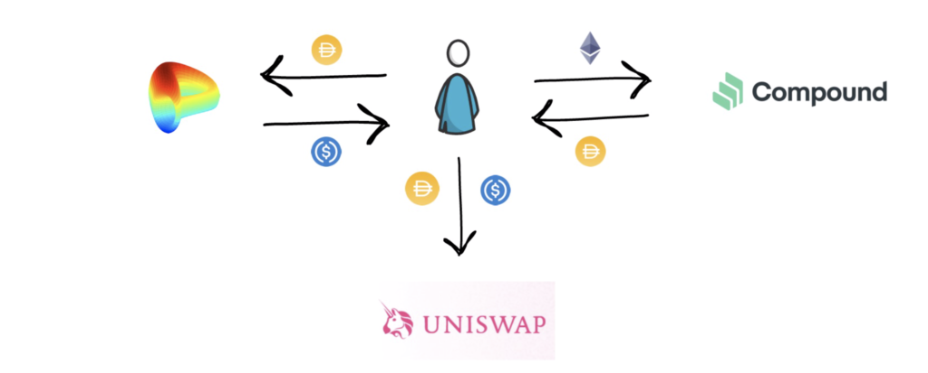
Ethereum Transactions
One Ethereum transaction can consist of multiple steps
You could supply ETH and borrow DAI on Compound
Swap half of your borrowed DAI for USDC on Curve
Provide liquidity to DAI/USDC pool on Uniswap
Above all in one single Ethereum transaction
if any of these steps result in an error, the whole transaction will be rolled back and none of the steps will take place
Remember – you will still pay gas fees, even for failed contract executions.
Notes:
https://www.youtube.com/watch?v=mCJUhnXQ76s
https://finematics.com/flash-loans-explained/

Slide 6
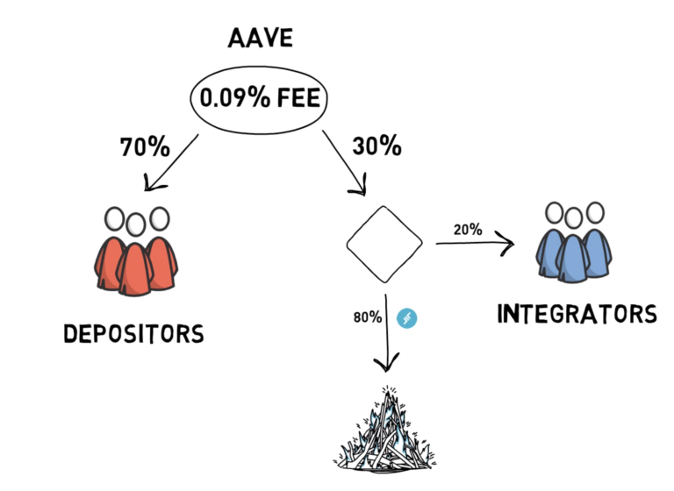
Flash Loans
First to find a flash loan provider
Aave, Compound, dYdX, Maker, etc
Users can borrow different coins from a designated pool under the condition that they are repaid within the same Ethereum transaction
There is usually a fixed cost associated with using flash loans
Aave contracts, for example, require the borrower to return the initial amount + an extra 0.09% of the borrowed amount
The fee is split between depositors, who provide the funds that can be borrowed, and integrators, who facilitate the use of Aave’s flash loan API. A part of this fee is also swapped to AAVE tokens and burned
Notes:
https://www.youtube.com/watch?v=mCJUhnXQ76s
https://finematics.com/flash-loans-explained/
https://www.coindesk.com/what-is-a-flash-loan

Slide 7
Flash Loans – Use Cases
There are 3 most common use cases for flash loans
Arbitrage. Flash loans can magnify the profit of executing a successful arbitrage opportunity.
Let’s imagine that there is a price discrepancy in the DAI/USDC pools between Uniswap and Curve.
You can trade 1 DAI for 1 USDC on Curve, but you only need 0.99 DAI to buy 1 USDC on Uniswap
Now you can try to execute the following arbitrage.
Borrow 100,000 DAI from Aave via flash loan
Swap 100,000 DAI for USDC on Uniswap and receive 101,010 USDC
Swap 101,010 USDC for 101,010 DAI on Curve
Repay initial 100,000 DAI + 0.09% fee = 100,090
Profit 920 DAI
Notes:
https://www.youtube.com/watch?v=mCJUhnXQ76s
https://finematics.com/flash-loans-explained/
https://www.coindesk.com/what-is-a-flash-loan

Slide 8
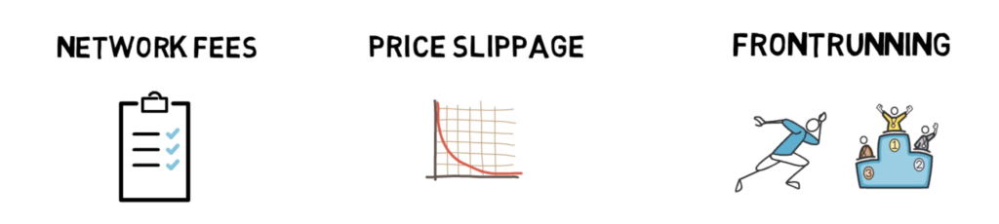
Flash Loans – Use Cases
This looks nice, but we have to take a few extra things into consideration
1. Network fees – arbitrage transactions with multiple steps can be quite expensive.
2. Price Slippage – always calculate how much price slippage you’ll experience while executing your order
3. Frontrunning – there is a high chance that someone else will spot the same opportunity and will manage to get their transaction mined ahead of you. On top of that, bots that monitor the mempool can pick up your profitable arbitrage opportunity and send the same transaction with a higher gas fee, profiting them instead of you, basically stealing your arb opportunity.
Notes:
https://www.youtube.com/watch?v=mCJUhnXQ76s
https://finematics.com/flash-loans-explained/
https://www.coindesk.com/what-is-a-flash-loan

Slide 9
Flash Loans – Use Cases
Collateral Swap– Let’s say you have borrowed DAI from Compound with ETH as collateral. You can swap your collateral from ETH to, for example, BAT in the following way:
Take a flash loan in DAI to cover the amount of DAI that was borrowed
Repay your Compound loan with borrowed DAI
Withdraw your ETH
Swap your ETH for BAT on Uniswap
Supply BAT as collateral on Compound
Borrow DAI against your BAT collateral
Repay flash loan with borrowed DAI + fee
Notes:
https://www.youtube.com/watch?v=mCJUhnXQ76s
https://finematics.com/flash-loans-explained/
https://www.coindesk.com/what-is-a-flash-loan

Slide 10
Flash Loans – Use Cases
self-liquidation –
You have a loan in DAI on Compound with ETH as collateral.
The ETH price keeps going down and you’re approaching the liquidation level
You also don’t have or don’t want to deposit more ETH to decrease your liquidation level and you also don’t have the DAI required to repay the loan
Now, instead of allowing the MakerDAO contract to liquidate your collateral and charge you the liquidation fee, you can take the following steps:
Take a flash loan for the amount of DAI that you owe
Repay your DAI loan and withdraw your ETH
Swap enough ETH to DAI in order to repay the flash loan + fees
Keep the rest of your ETH
These were the 3 most common use cases for flash loans. Of course, the concept of flash loans is quite new and there are still a lot of use cases to be discovered in the future.
Notes:
https://www.youtube.com/watch?v=mCJUhnXQ76s
https://finematics.com/flash-loans-explained/
https://www.coindesk.com/what-is-a-flash-loan

Slide 11
Decentralized Exchanges
24/08/2021

Slide 12
CEX Vs. DEX
CEX: Centralized Exchange
Registered company, have offices, Employees, shareholders and all physical infrastructure
If falls under restrict regulation in country, KYC, AML, etc.
No wallet custody, held on exchange wallet
Coinbase
DEX: De-centralized Exchange
No real company, no offices, no employees,
Just a team of distributed developers who involved to build protocols by using of smart contracts on ethereum Blockchain
Governance move to the token holders (you and I)
No regulation apply (KYC, AML, etc.)
Anyone can access to exchange
Use your own wallet
Transparent transaction, publically verifiable, permissionless
Anyone can mint token, scammers thread, no customer support
Uniswap
Notes:
https://www.youtube.com/watch?v=A_43UI5edHk

Slide 13

Uniswap is a decentralized token exchange protocol
Built on Ethereum that allows direct swapping of tokens w/o CEX
In CEX you need to deposit tokens to an exchange place an order on the order book, and then withdraw the swapped tokens
In uni you swap your tokens directly from your wallet
All you need to do is send your tokens from your wallet to Uniswap’s smart contract address
You will receive your desired token in return in your wallet
Token exchange rate is determined algorithmically
All this is achieved via liquidity pools and the automated market maker mechanism
Notes:
https://www.youtube.com/watch?v=A_43UI5edHk

Slide 14
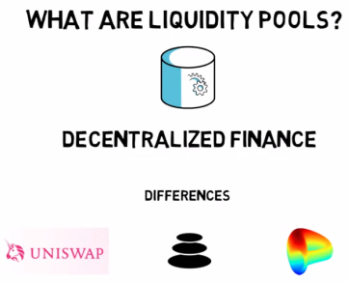
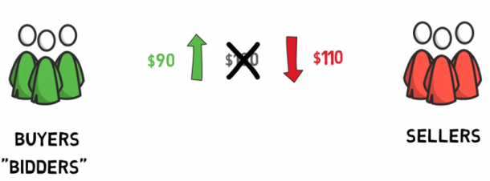
Liquidity Pools
LP is pools of token are locked in smart contract
Used to facilitate trading
Why do we need liquidity pools?
Coinbase and Binance trading on base of order book model
Same as the way traditional stock exchangers are working (NYSE, NASDAQ, KSE, etc.)
Buyers want to buy at low price and seller want to buy at higher price
This is where market makers comes to play

Slide 15
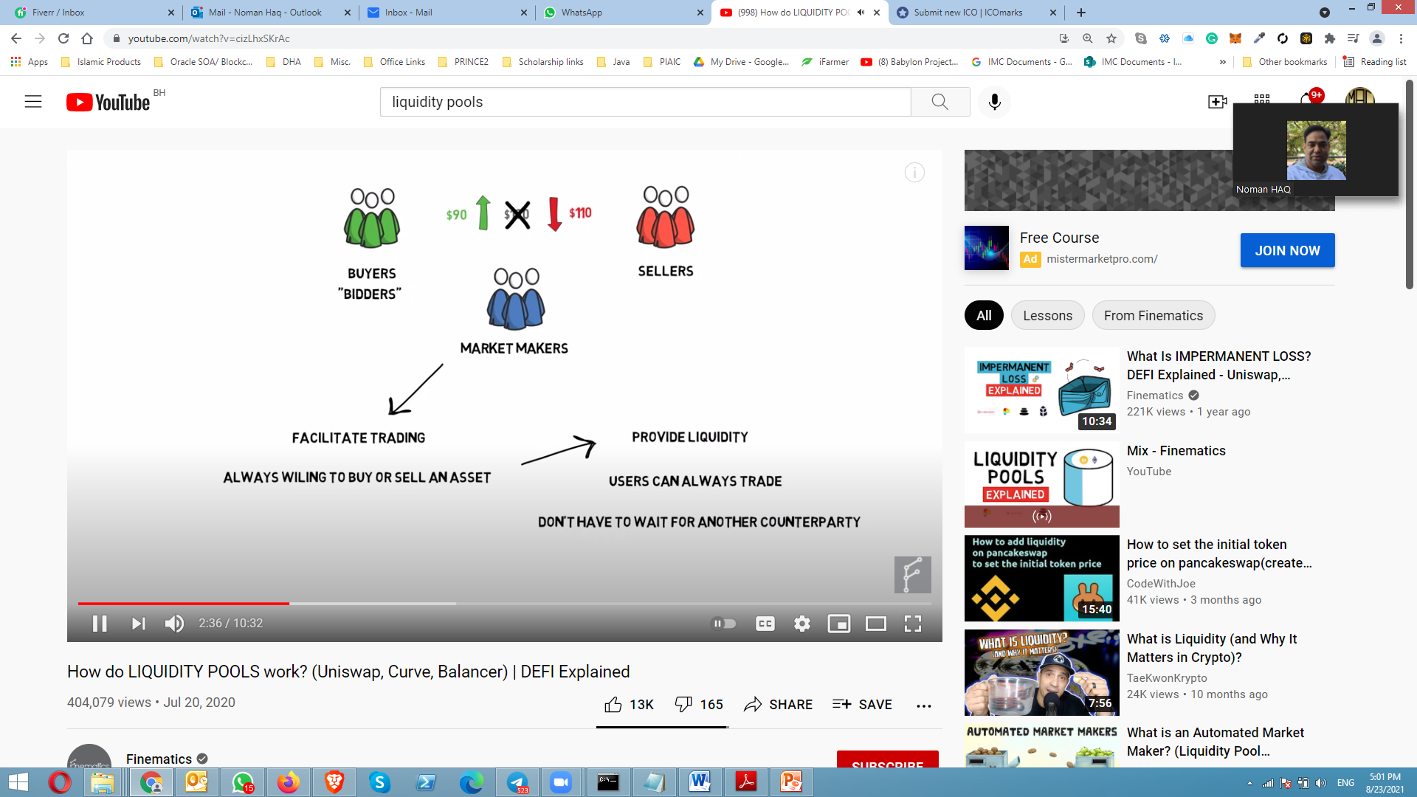
Market Makers
Market Makers are entity that facilitate the trading that always willing to buy or sell particular assets
By doing that they provide liquidity
So user can always trade and they don’t have to wait other counter party

Slide 16
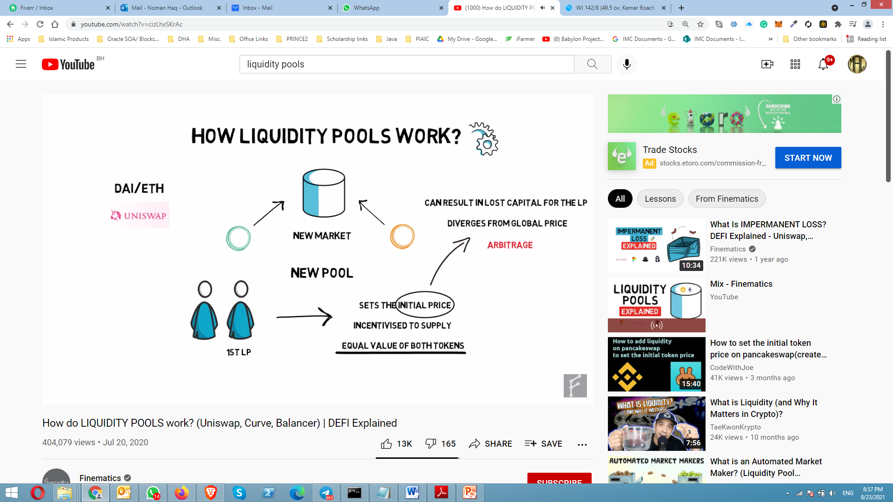
How LP works
In basic forms single liquidity pool holds 2 tokens
Each pool create new market for particular that pair of token
DAI/ETH is popular liquidity pair of uniswap
When new pool is created the first liquidity provider set the initial price of asset in the pool
LP incentivized to supply equal value of both token in the pool
This ration will remain same for other liquidity provider who are willing to add more fund in the pool latter

Slide 17
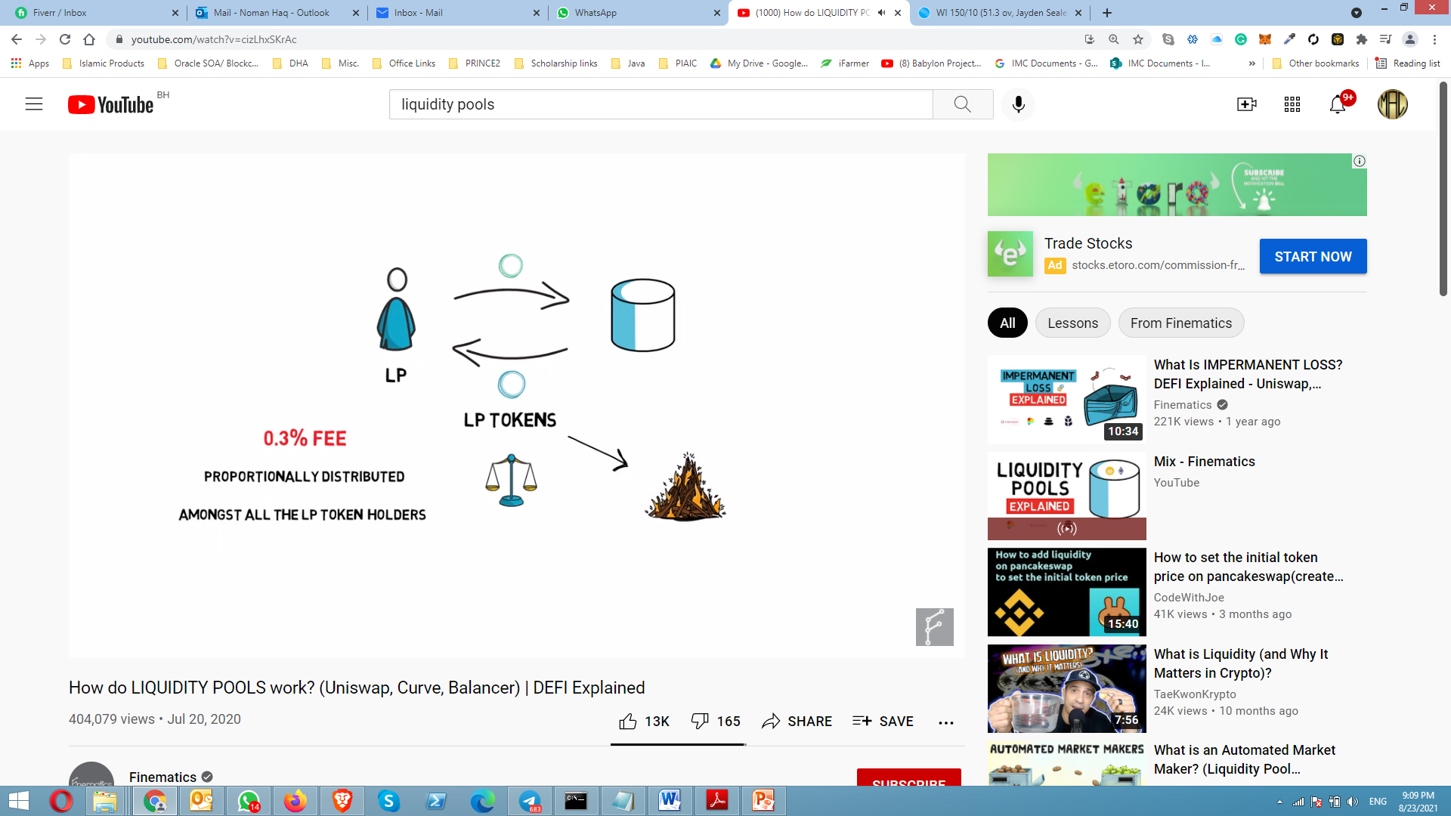
How LP works
When liquidity is supplied to the pool, the LP receive special token called LP tokens in proportion how much liquidity they supplied in the pool
When the trade is facilitated by the pool 0.3% fees is proportionally distributed amongst the all LP token holders
If liquidity provider wants to get there underlying liquidity back plus any accrued fees they must burned there LP tokens

Slide 18
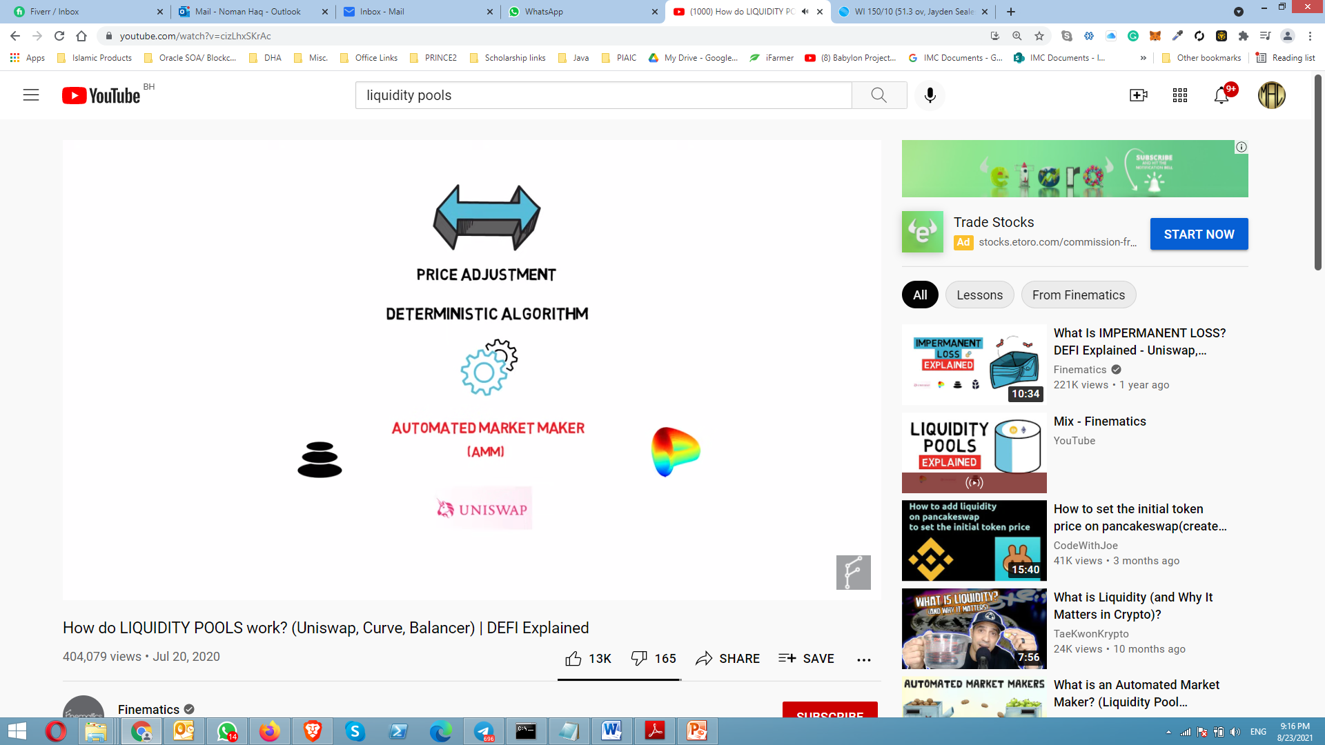
Automated Market Maker
Each token swap that Liquidity pool facilitate results in price adjustments
According to deterministic pricing algorithm
This mechanism is also called Automated Market Maker (AMM)
Liquidity pool across different protocols use slightly different algorithm
Notes:
https://www.youtube.com/watch?v=cizLhxSKrAc

Slide 19
Thank You

